Slide 1
STRANGER THINGS
GAME
19-204-0713 MINI PROJECT – MULTIMEDIA PROJECT

Slide 2
Submitted by
Anupriya Asok – 20419506
Anzil Nizar – 20419507
Neeraj N – 20419520
Nived P – 20419522
Syam Suresh P C - 20419535

Slide 3
Overview
Stranger Things - game is a first person shooter (FPS) game in which the player assume the role of a survivor known as Eleven, fighting its way through hordes of invading creatures from stranger things universe (upside down). This science fiction game is inspired from popular stranger things television series. The monsters have very simple behavior, consisting of either moving toward their opponent, or by shooting. The game utilizes the multimedia aspect by incorporating high quality MP3 audios and detailed visuals of each monsters and also the same goes with the background images and map. On attack, the life of the player decreases gradually and keeps on increase while not in combat mode.

Slide 4
Introduction
STRANGER THINGS is a fun and addictive first person shooter game in which enemies often appear in large groups thus increases the quantity and damage done by enemies. The monsters have very simple behavior, consisting of either moving toward their opponent or by shooting. The life of the player decreases as the intensity of attack increases and at last the player is greeted by victory screen once all the enemies are defeated. This science fiction game is inspired from popular stranger things television series.

Slide 5
Objectives
The game is developed for full-time entertainment and enthusiasm.
The main objective of this game is to hit the enemies and to survive.
Easy gameplay and simple GUI is provided.
Kid friendly approach is implemented due to the game’s simplistic design.
Controls of the game are very easy & user friendly.

Slide 6
Purpose
This game will be implemented using Python language and Pycharm IDE.
Python is a high-level, general purpose programming language. Whereas Pycharm is an integrated development environment (IDE) used in programming & developed specifically for python.
The game will ensure that the UI is understandable and user can play the game without any prior interpretations.

Slide 7
Requirements
1. Functional Requirements
Profile : A player can have their own profile with an elaborate high score window.
Levels : The game incorporates level system in which as the level proceeds , the more intense the game becomes.
High Score : Each player will have their own score and scores are arranged on their personal achievements.
Soundtrack : It includes a main background score and defined sounds for various in-game actions such as attacks, pain etc.

Slide 8
2. Non-Functional Requirements
Usability
The game is very easy to understand and any user can play it.
Functionality
The application provides a set of functions and controls that
the system equips to the user.
Feasibility
The game allows user to control the main player as he/she
wishes by utilising the given control buttons and play without
any interruptions.

Slide 9
3. External Interface Requirements
User Interface
The game is an intuitive application and users don’t
need any kind of assistance or prior knowledge about it.
Hardware Interface
Storage: 100 MB of free disk space
RAM: 256 MB or higher
CPU: Intel Pentium Dual Core
Display Resolution: 800x600 (min)
Adobe Flash Player

Slide 10
Software Requirements
Operating System: Windows 7 or above
Softwares: Python
Pycharm

Slide 11
Design
The game consists of the design elements in a constrained world such as pixelated png images with set of movements.
It includes a main background score and defined sounds for various in-game actions such as attacks, pain etc.
The design also incorporates a accurate health bar located on the left side which increases and decreases upon attack.
Depending upon the game outcome the player is greeted with either a “Victory” or a “Game Over” screen.
The UI of the game was designed using the Figma tool.

Slide 12
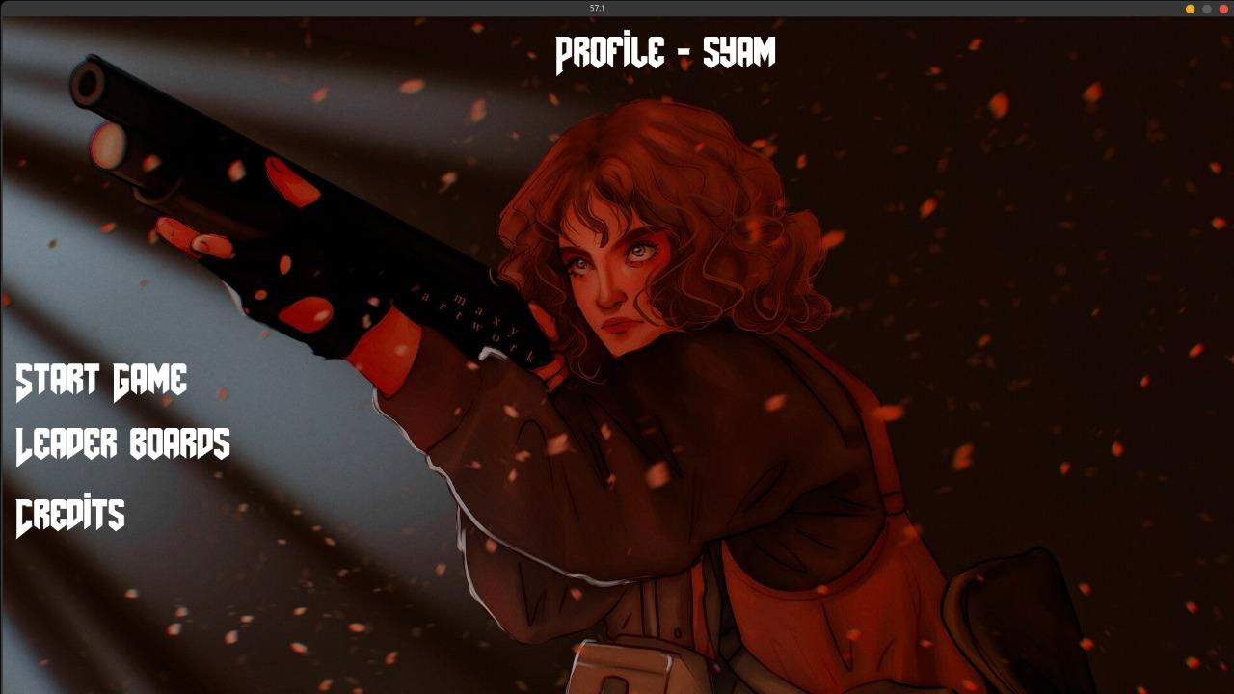
User Interface

Slide 13
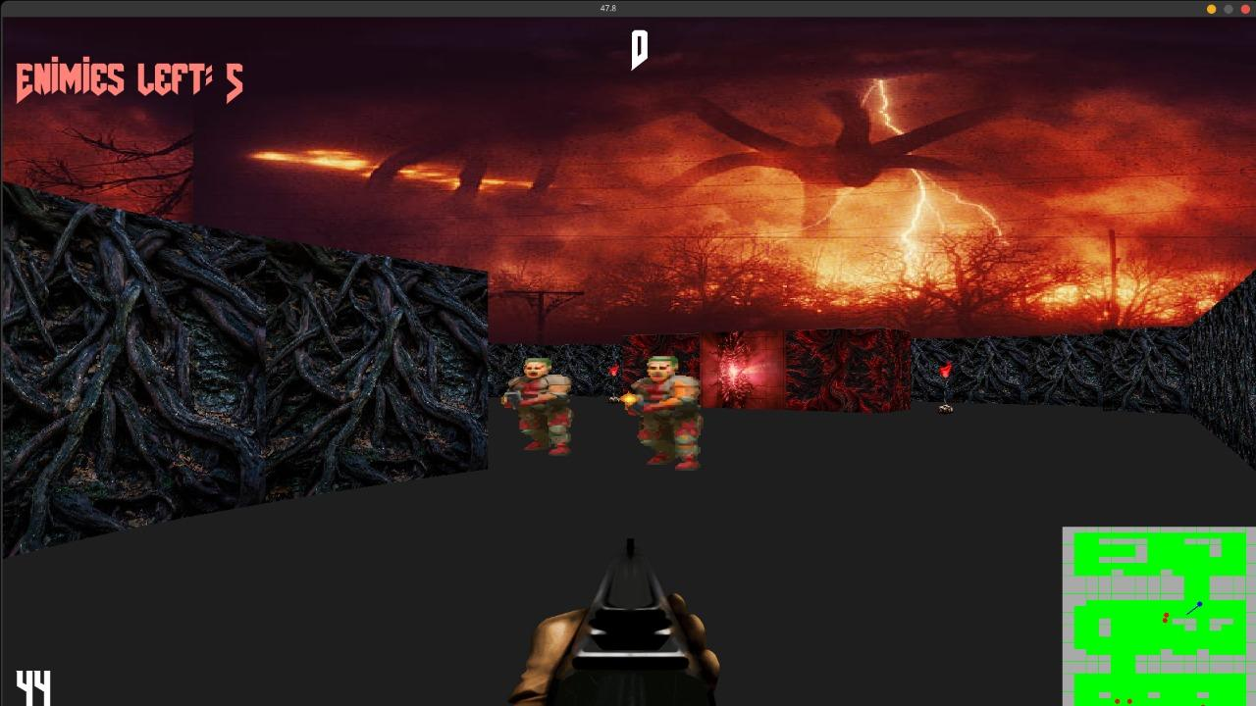
Output Screenshots

Slide 14
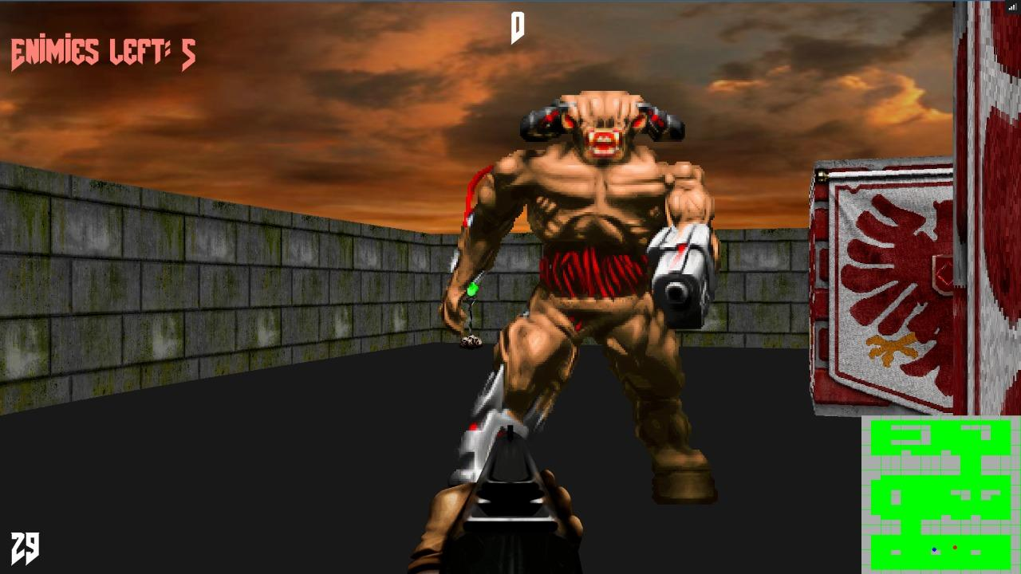
Output Screenshots

Slide 15
Testing
In the testing phase, the control as well as the completeness of the animation is being tested.
When the controls are pressed, for example: when the control ‘W’ is pressed the main player will move forward, when ‘A’ key is pressed the main player will move to the left, when ‘D’ is pressed the player will move right side and when ‘S’ key is pressed the player will move backwards. The mouse right click will activate firing.
Throughout the testing phase, the animation as well as the controls are being tested.
It is checked whether the computer system has been installed correctly.
.

Slide 16
.
Evaluation
Project Evaluation is a step-by-step process of collecting, recording and organizing information about project results, including short-term outputs (immediate results of activities, or project deliverables), and immediate and longer-term project outcomes (changes in behaviour, practice or policy resulting from the project)
Continuous challenge: Game provide continuous challenge to the user and sustain the element of fun that keep them hooked on playin the game.
Interesting story line: The game has a very interesting plot which will keep them motivated to succeed.
Flexibility: Each player workout their own strategy to the end point while keeping the game challenging and achieving the learning objectives.
Combining fun and realism: Excessive realism can be boring.We incorporate many incorrect assumptions or rewards that have unrealistic behaviours.

Slide 17
Future Scope
In the further stages of the game more features like new characters , mini map , new weapons , can be implemented.
More features like online multiplayer capability can also be added in the further updates.

Slide 18
Conclusion
We learned a lot through this project. This project has sharpened our concept of Game engine, animation and the software-hardware interface. We learned a lot about different documentation. The piece of software we developed is intended to serve the gamers of the world. The success of this project may give pleasure to billions of game lovers among the universe. This project not only tested our technical skills but also our temperament. There were times that we almost lost hope but we recovered through constant concentration and hard work.If any kind of suggestion, improvements, more efficient development idea please feel free to communicate with us.

Slide 19
THANK YOU!

